Slide 1


1
Speak Like a Native

Slide 2

Background
“In 2013, I applied scholarship for master degree. One of the requirement is IELTS. Speaking is one of the part of test. In My first attempt, I failed to reach minimum score for speaking band. To improve my speaking I take a lot of traditional course, however due the class size too big, I felt that I just waste my money because I did not get enough time to speak”
- Baihaki Ageng Sela, CEO Natieva
2

Slide 3


Problem
For Student
Traditional english course is not improving speaking ability due to size of class which makes student has less speaking time.
Inflexible schedule.
Traffic jam and distance to the course location.
3

Slide 4

Problem
for Teacher
Immigration issue
Unequality Opportunity
Unfair Rate
4

Slide 5


5
Natieva Solution
Increasing flight time of speaking.
Online one-on-one video call english course.
Flexible schedule and class
Native speaker from all over the world.
Random teacher and flat rate

Slide 6
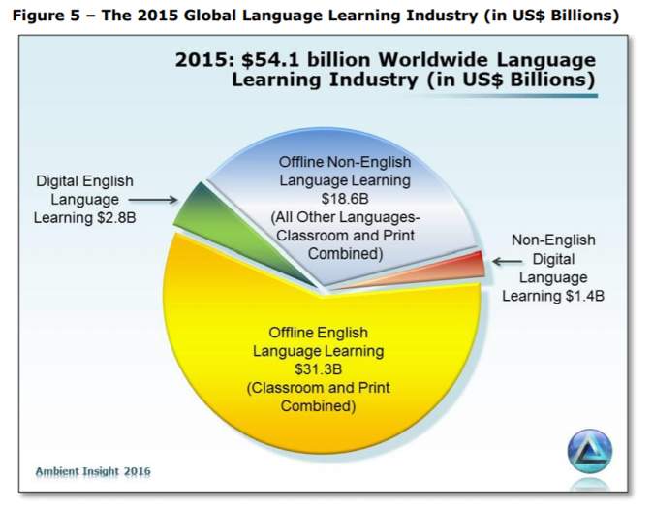

6
Market
ASIA
ASIA
2017
2022
$1.6B
$2.7B

Slide 7
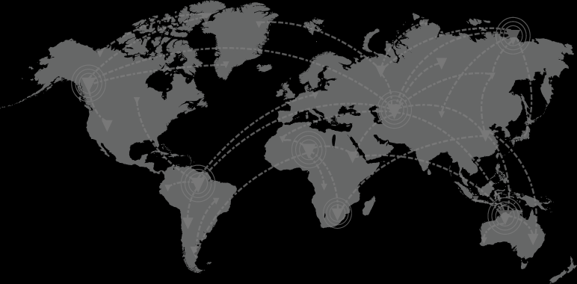
7
2015
2022
China
US
South Korea
Japan
Brazil
India
Taiwan
China
US
South Korea
Brazil
Japan
Indonesia
Taiwan
Top 7 Digital English Languange Learning Buying Countries
Source: Ambient Insight 2016

Slide 8
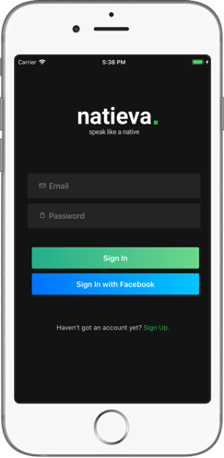

8
Business Model
Mobile Learning VAS
(Value Added Services)
One on One Tutor with Curicullum
(Business English, Ielts/Toefl Preparation,kids)
Future Business Model
Monthly Subcription (Content, games, lms)
One Payment Services (Proofreading, Translation)

Slide 9
9
End User
Monthly Subcription
Levelling
Corporate
Monthly Subcription
Co Branding Learning App
Government
Revenue Model
Free lesson for the citizen
Our Project : Tangerang Selatan Belajar with Natieva

Slide 10

10
Financial Projection
First Year Goals
(2018)
1000 pengguna aktif
Rp. 1.750.000/person
Rp. 1.750.000.000
Long Term Goals
(2022)
30% digital market in Indonesia
10% digital market in South East Asia

Slide 11


11
Natieva Video

Slide 12
SMS OTP
Telkom
Xsight API
SMS OTP dipakai untuk meng-authentifikasi user ketika register pertama kali.
SMS Notification
SMS notifikasi dipakai untuk konfirmasi berhasil atau tidaknya pembelian paket.
T-Money
T-Money digunakan untuk membayar paket yang ada didalam aplikasi.

Slide 13
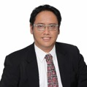
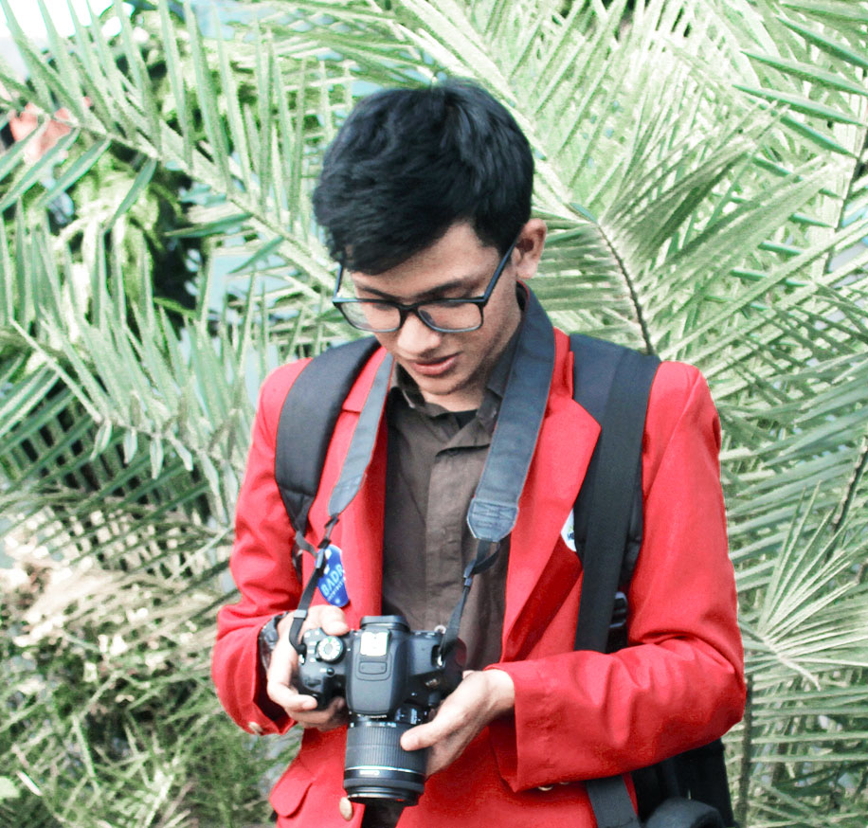

13
Natieva Team
Baihaki Ageng
Sela, S.Kom, MM, M.Com
Vive Vio
Permana S.Kom
Arifullah, S.Kom

